Slide 1

Javascript Events
M3-09
Participate! The more engagement the better! You are NEVER interrupting me!

Slide 2
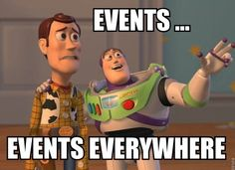
Session Objectives
Select DOM objects and attach anonymous functions with addEventListener()
Describe event bubbling and how it works
Describe default browser behavior and what elements default behavior needs handled for (form,a)
List possible event types and what elements get those events
Describe how to add listeners to newly created DOM elements
Remove an event listener with removeEventListener()

Slide 3
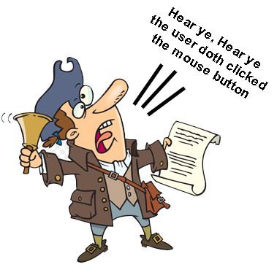
Events
Actions or Occurrences that happen in the system or your application, which the system tells you about so you can respond
When the user takes an action, like click a mouse button, the Operating System “screams” out to any application that is interested that the event occurred.
Applications that are interested in that event register an Event Listener that “hears” the event and allows the program to take action.

Slide 4
Web Events
When a user takes an action in the browser window, the browser raises an event letting application running it know that the event occurred
Everything the user does raises some sort of event, or sometimes multiple events, allowing the programmer to choose what events they care about and what actions they want to take in response.
Many of the actions the browser or HTML elements take are also raised as events that can be handled.
Example of user actions
User clicks a mouse button
User pressing a key on the keyboard
User moves the mouse
Example of browser/html actions
form submits
page has finished loading
textbox value has changed
browser has been resized

Slide 5
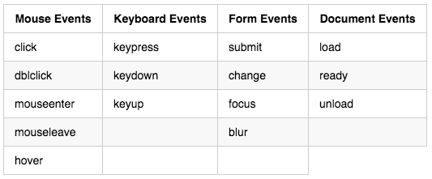
Common Web Events
Mouse Events
mouseenter -
mouseleave -
hover -
Keyboard Events
keypress -
keydown -
keyup -
Form Events
focus-
blur -
Document Events
load - all images, css, resources, etc loaded
DOMContentLoaded (ready) - DOM loaded
unload - page unloads
List of Events:
(https://www.w3schools.com/jsref/dom_obj_event.asp)

Slide 6
User Interface Events
These occur as a result of interaction with the browser window, not the HTML.
.load - fires when page finishes loading all images, css and resources
.unload - fires before a user leaves the page (e.g. moves to a new page)
.error - fires when the browser encounters a JavaScript error.
.resize - fires when we resize the browser window (best to let CSS handle this)
.scroll - fires when the user scrolls up/down on the browser window

Slide 7
Focus and Blur Events
These events fire when the HTML elements you interact with gain or lose focus:
.focus - fires when a specific element gains focus
.blur - fires when a specific element loses focus

Slide 8
Mouse Events
.click - fires when the user clicks the primary mouse button
.dblclick - fires when a user presses the primary mouse button in click succession, twice.
.mousedown - fires when the use clicks down on a mouse (e.g. drag and drop)
.mouseup - fires when the user releases the mouse button (e.g. drag and drop)
.mouseover - fires when the user moves the cursor inside an element area
.mouseout - fires when the user moves the cursor out of an element area
.mousemove - fires everytime a mouse cursor moves

Slide 9
Keyboard Events
.input - fires when the value of an input or text area changes.
.keydown - fires when the user presses any key on the keyboard
.keypress - fires when the user presses a specific key on the keyboard
.keyup - fires when the user releases the key

Slide 10
Form Events
.submit - fires when the user submits a form
.change - fires when a form element changes
.input - fires often with form text fields. (Often use blur and focus here as well)

Slide 11
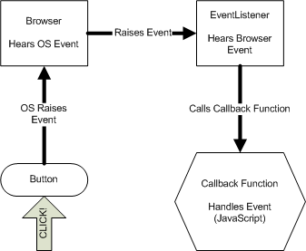
Event Handling
The receipt of an event at some event handler that was raised by an event producer
The event producer raises the event (the user clicked on a button), the event handler receives the event and forwards it to a callback function, which is a function in our code that will react to the event.
Event handling is managed in JavaScript not CSS or HTML

Slide 12
Event Listeners
To react to an event we must register an EventListener, this tells the browser that we are interested in the event and want to react to it.
When the EventListener a callback method is provided. When the EventListener is informed that the event has occurred it will call our callback method. In JavaScript we provide a callback method as an anonymous function that we pass to the eventListener when we create it.
document.addEventListener(eventType, eventHandler)
document - The element we want to listen for an event on
addEventListener - Adds an Event Listener Documentation
eventType- the event we want to add a listener for. Documentation
eventHandler - A callback function for the eventListener to call when the event occurs. This can be an anonymous function or a named function.
document.addEventListener('DOMContentLoaded', (event) => {
Code here to react to the event});
document.querySelector(‘button’).addEventListener(‘click’, (event) => {
Code here to react to the event
});

Slide 13
Click A Button Example
// Get the DOM elements you want to handle events for let button = document.getElementById('save_button');
// Write a function that will handle the event function saveForm(event) { //do something }
// Add the function to the DOM element by adding is as a listener button.addEventListener('click', saveForm); // No parentheses on the function name!
Note: You can call addEventListener() on elements that have been created but not added to the DOM yet.

Slide 14
Page Loading Event - DOMContentLoaded
The DOMContentLoaded event fires when the initial HTML document has been completely loaded and parsed, without waiting for stylesheets, images, and subframes to finish loading. document.addEventListener('DOMContentLoaded', () => { setPageTitle(); setPageDescription(); displayReviews(); })

Slide 15
Event Object
The event object is created by the browser and contains specific information based on the ‘type’ of event. For example, mouse events would have more specific information about mouse events, and so on for other event types.
https://www.w3schools.com/jsref/obj_events.asp

Slide 16
What happens when the submit button is clicked? How does the form know when to fire it’s action?
<form action = “/server/api/submitform” method=”post”>
<input box 1>
<input box 2>
<submit button>
</form>

Slide 17
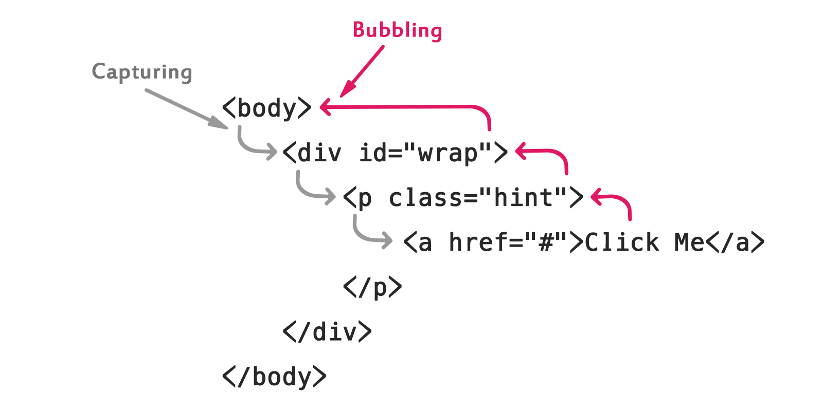
Event Bubbling and Capture
Capturing comes from the browser inward. We usually don’t care about that.
Almost all events from our perspective Bubble. Those are typically the actions the user is making in our app.
Visual example: https://javascript.info/bubbling-and-capturing

Slide 18
event.stopPropogation() Method
The event.stopPropagation() method stops an event from bubbling/capturing. Ex: So if a button was clicked, we could stop that button’s default handling with event.preventDefault() but if we do not stop the event from bubbling or capturing, other event handler’s could receive an event.

Slide 19
event.preventDefault() Method
The event.preventDefault() method stops the default action of an element from happening.
For example:
Prevent a submit button from submitting a form
Prevent a link from following the URL

Slide 20
Let’s go code some
Product Reviews

